Slide 1

SCHOOL OF COMPUTATIONAL SCIENCES,
SWAMI RAMANAND TEERTH MARATHWADA UNIVERSITY,
NANDED (M.S.) 431606
YEAR 2022-2023
ACCOUNTING SYSTEM FOR APMC
PROJECT REPORT
SUBMITTED BY:
KENDRE DHANRAJ BALAJI
MSc CS SY
[VZ10363]
GUIDED BY DIRECTOR
Dr H. S. FADEWAR Dr G. V. CHOWDHARY

Slide 2
INTRODUCTION
What is APMC?
APMC means the Agricultural Produce & Market Committee which is a government organization responsible for regulating and overseeing the marketing of agricultural produce in India.
What is ACCOUNTING FOR APMC?
As the name suggests, it refers to the financial management system which records, track and manage financial transactions and operations. I have created an accounting system software that can streamline financial management tasks, improve data accuracy, and provide real-time financial reporting also minimizing the paperwork with UPI option for payment encouraging cashless transactions.
What is the need of ACCOUNTING FOR APMC?
Current manual accounting process is time-consuming, error prone and not scalable.
The lack of automation in financial transactions and data management leads to inefficiencies and inaccuracies in financial reporting, which can negatively impact the organization’s decision-making, financial analysis.

Slide 3
PROPOSED SYSTEM
Proposed System
In my proposed system, I have the provision for adding the records of proprietors, financial transactions by all the employees of APMC. Another advantage of the system is that is also includes the Proprietor Management System along with Recording Transactions. The records of the transactions are added in the database so the admin can view the data whenever he/she want.
Advantages
User friendly interface and environment
Fast access to database
Less error
More storage capacity
Search facility
Track records

Slide 4
USER REQUIREMENTS
SOFTWARE SPECIFICATIONS
Browser
Python
Django Library
Pandas Library
HARDWARE SPECIFICATIONS
A processor good enough to support browsing the internet
A RAM with size at least 4 GB
LAN Card for internet connectivity

Slide 5
SYSTEM DEVELOPMENT
Which SDLC model is used?
AGILE MODEL
Agile SDLC model is a combination of iterative and incremental process models with focus on process adaptability and customer satisfaction by rapid delivery of working software product. Agile method breaks the product into small incremental builds. These builds are provided in iterations. Each iteration typically lasts from about one to three weeks. Every iteration involves cross functional teams working simultaneously on various areas like planning, requirement analysis, design, coding, unit testing and acceptance testing. At the end of the iteration, a working product is displayed to the customer and important stakeholders.

Slide 6
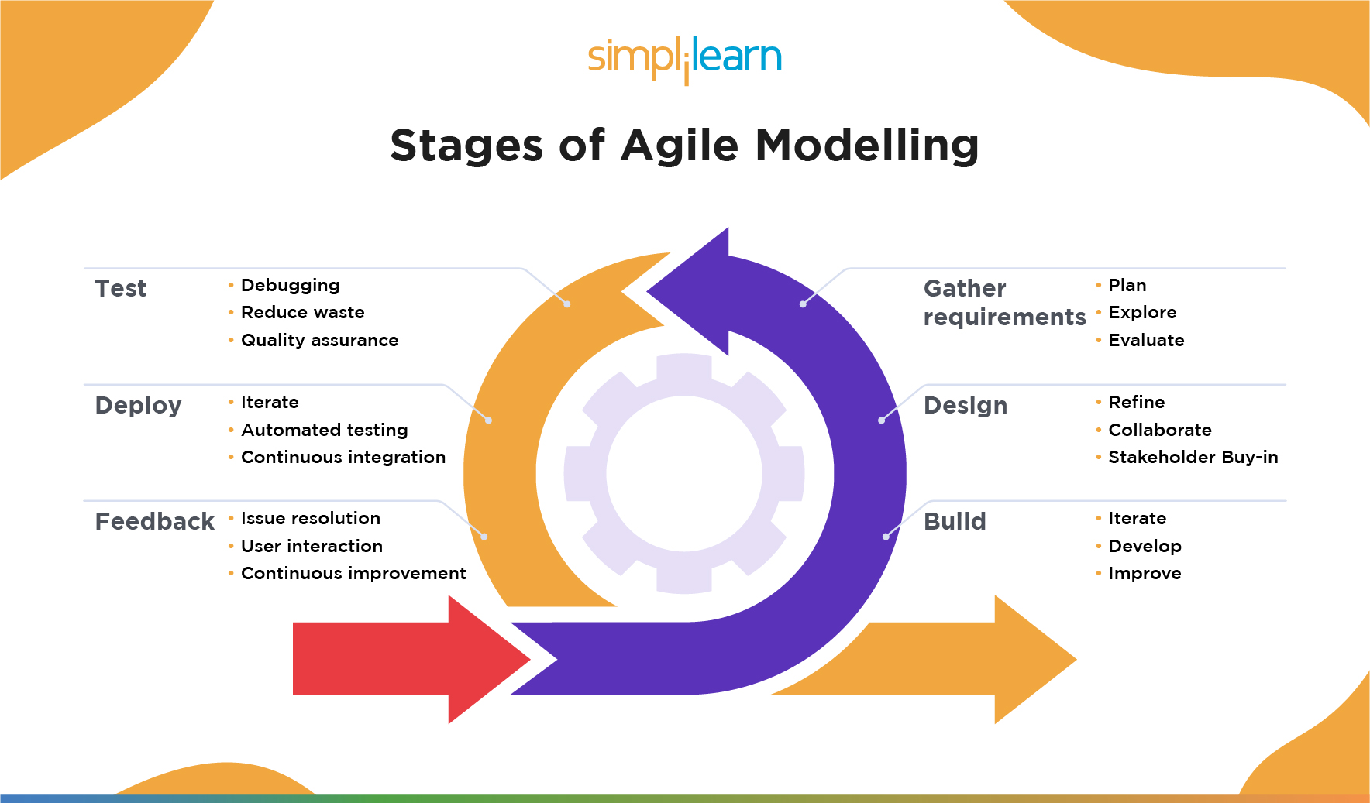

Slide 7
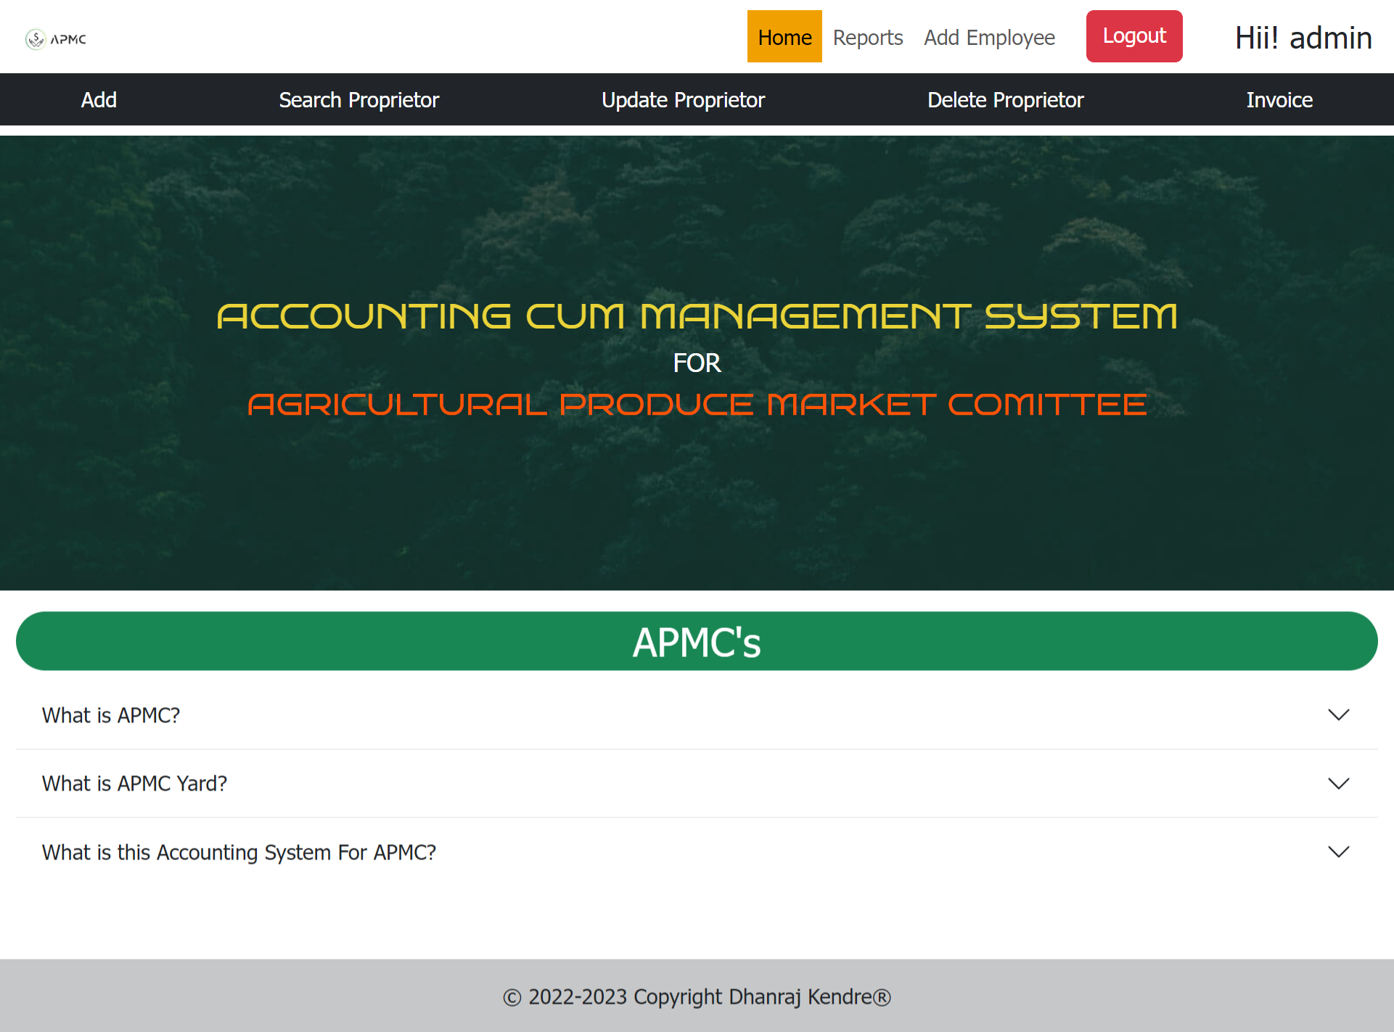
FRONT END DESIGN
Fig. INDEX SCREEN

Slide 8
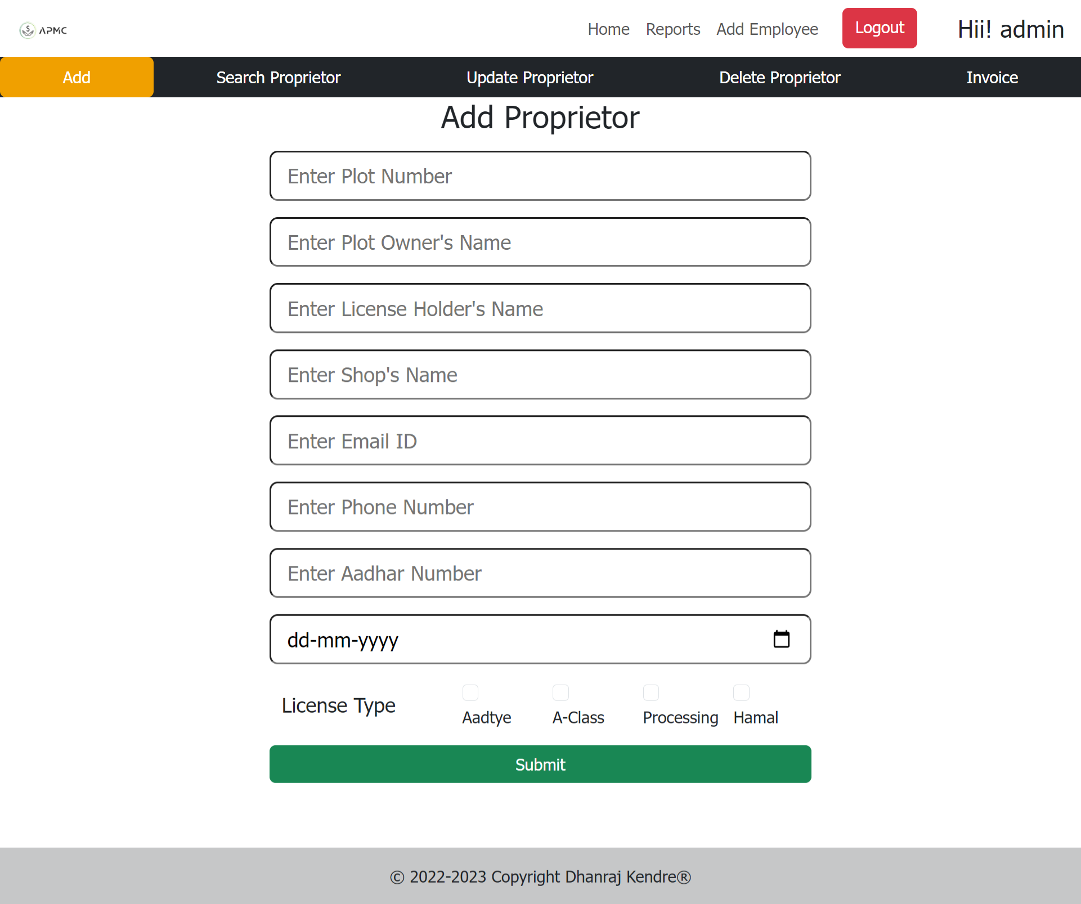
FRONT END DESIGN
Fig. PROPRIETOR SCREEN

Slide 9
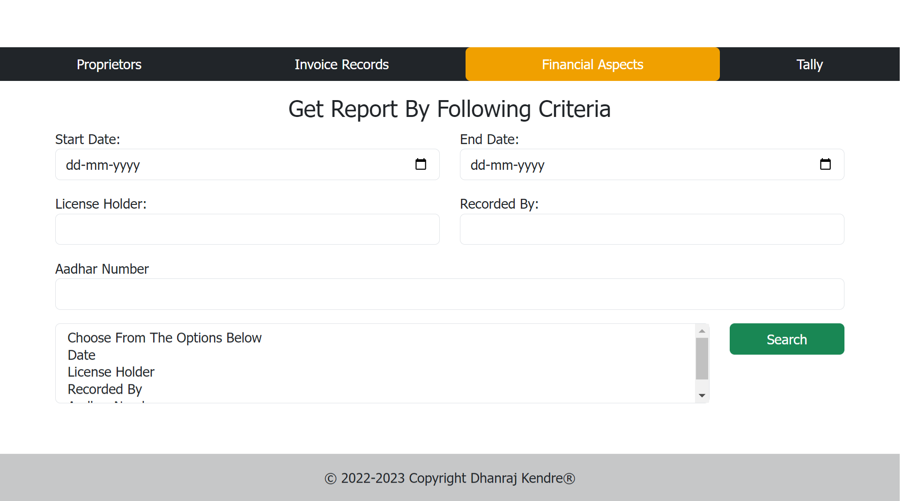
FRONT END DESIGN
Fig. REPORT SEARCH SCREEN

Slide 10
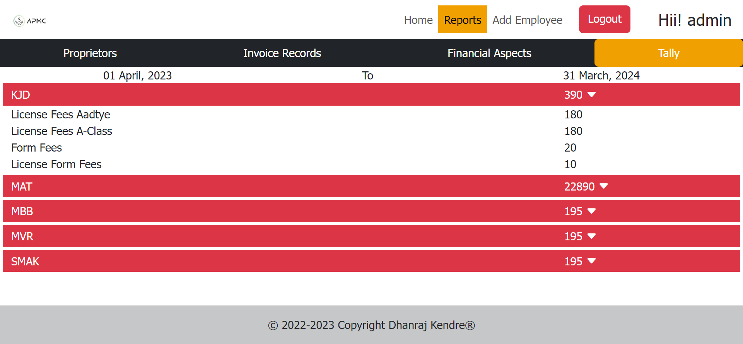
FRONT END DESIGN
Fig. TALLY SCREEN

Slide 11
ADVANTAGES
This software can reduce the risk or errors in financial transactions and data management.
This software can streamline financial management tasks such as invoicing, billing and payment processing, which can save time for employees.
This software can provide real-time financial reporting.
This software can improve overall efficiency by automating processes and providing a centralized databases for financial data management.
This software can help save money by reducing the need for paper-based processes and redundant tasks.
DISADVANTAGES
Employees may need time to learn how to use the new accounting system software, which can temporarily slow down productivity.
This system software is heavily reliant on technology which can be problematic if there are technical issues such as power outages, system failures.
Although, this system can reduce the risk of errors, there is still the potential for user error if employees do not input data correctly or misinterpret the data.

Slide 12
CONCLUSION
CONCLUSION
This system plays a crucial role in managing the financial operations and transactions within the committee. Such a system offers several benefits including efficient financial management, accurate financial records, improved decision-making, etc.
FUTURE SCOPE
The future scope for Accounting System for APMC lies in automation, integration, mobile accessibility, analytics, compliance, cloud-based solutions, blockchain technology and sustainability reporting. By embracing these advancements, APMCs can enhance financial management.
PROPOSED ENHANCEMENTS
Graphics
Adding Expenditure Records
More Report Formats

Slide 13
REFERENCES
I would like to mention some sources which proved to be helpful in making this project, some of them are as follows:
https://openai.com/
https://www.python.org/doc/
https://docs.djangoproject.com/en/4.1/
https://getbootstrap.com/docs/5.3/getting-started/introduction/

